Slide 1
Global Data Transfer Form
Instructions for completing the GDTF form

Slide 2
Section 1 – Client Information
Name of the Corporation as it is registered with American Express
Six digit Company ID or Master/ Basic Control account number issued to the company

Slide 3
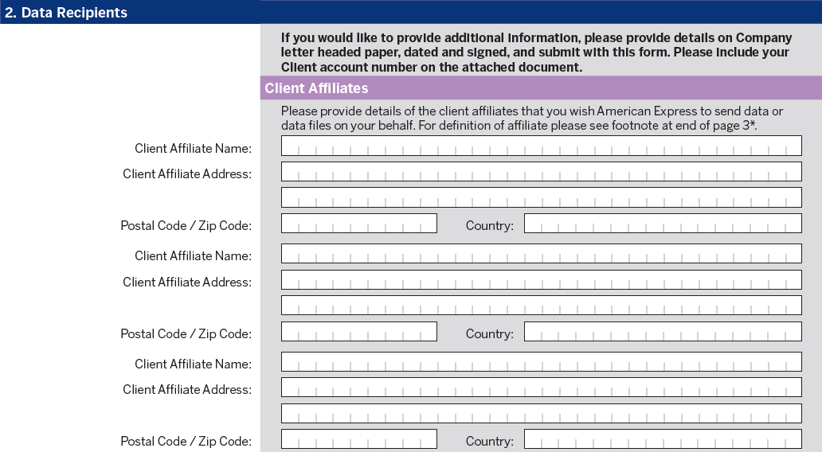
Section 2 – Data Recipients (Client Affiliates)
‘Client Affiliates’ field is Optional - Complete this section if data will be sent to a subsidiary or other legal entity.
* Please note: If there are more affiliates than the space allocated, please attach a list of additional affiliates on your Company Letterhead and have it signed by the authorized signatory and submitted with the form.

Slide 4
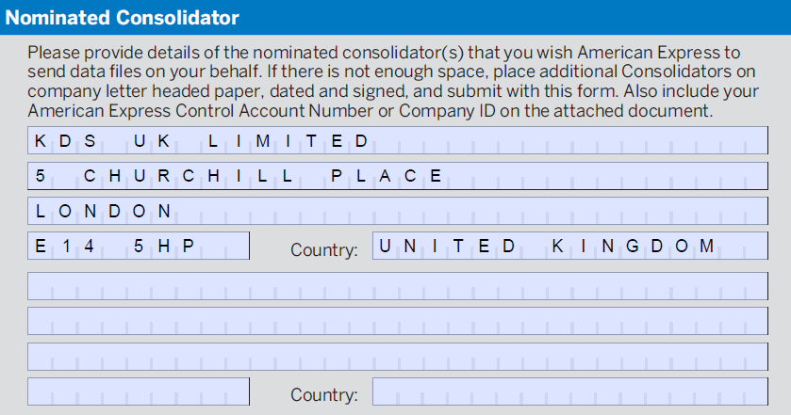
Section 2 – Data Recipients (Nominated Consolidator)
‘Nominated Consolidator’ field has been completed for you.

Slide 5
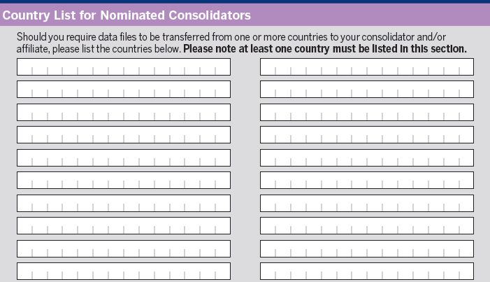
Section 2 – Data Recipients (Country List)
Provide the countries for which data files need to be setup.
For example USA or Canada.
* Please note: If the list of counties is longer than the space allocated on the form, please attach a list of counties on your Company Letterhead and have it signed and dated by the authorized signatory and submitted with the form. It is ok to add all countries in which you may send data even if not setting all up on data file initially.

Slide 6
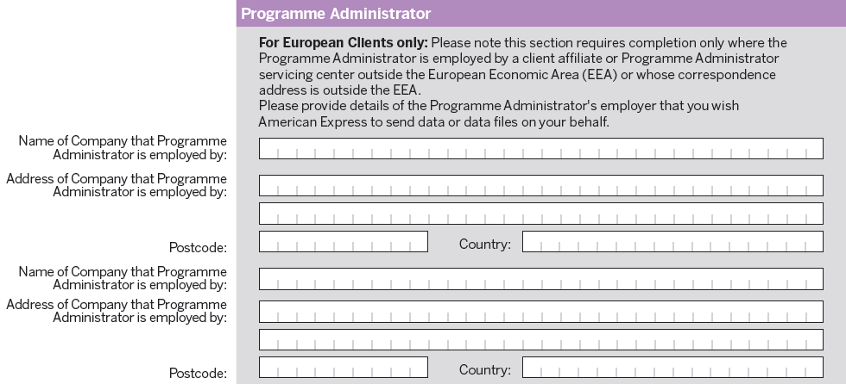
Section 2 – Data Recipients (European Clients only)
‘Programme Administrator’ section is Optional – For European Clients Only
*Please complete this section if a company employee will be accessing the data from the same company but from a different legal entity.

Slide 7
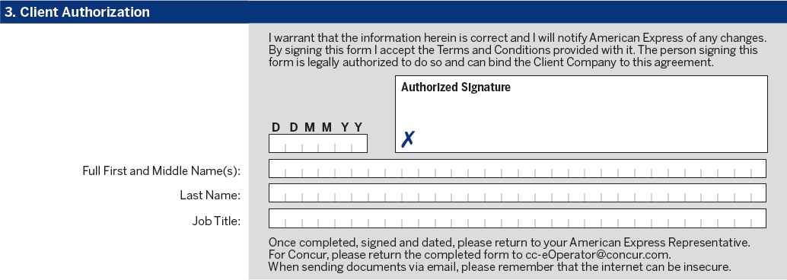
Section 3 – Client Authorization
‘Client Authorization’ field needs to be completed by the authorized signatory. Please provide First/ Last Name & Job Title along with Date and Signature.
Signature
Date
Name
*Please note that all the pages of GDTF form including terms & conditions should be sent for data file implementation requests.
* Ensure the entire document is in readable format without any errors. In the case of any errors, please complete a new form.

